Slide 1
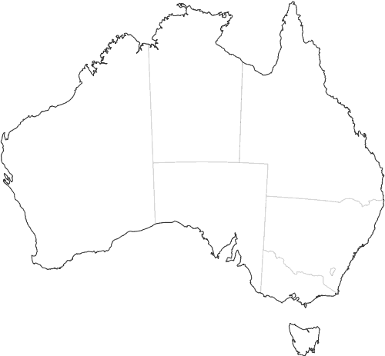
State Contacts
First port of call for any ALSA items
Organise the LSS/A Planning day
Disseminate information
Feedback loop to ALSA Committee meetings
QLD: Lachlan Robb & Grace Norris
WA: Chris Burch & Blackstone Pres
NSW: Andreena Kardamis & Simon McNamara
ACT: Alex Bell-Rowe
SA: Michaela Olsson
VIC: Cassandra Page
TAS: Andrew Lonergan

